Slide 1


Slide 2
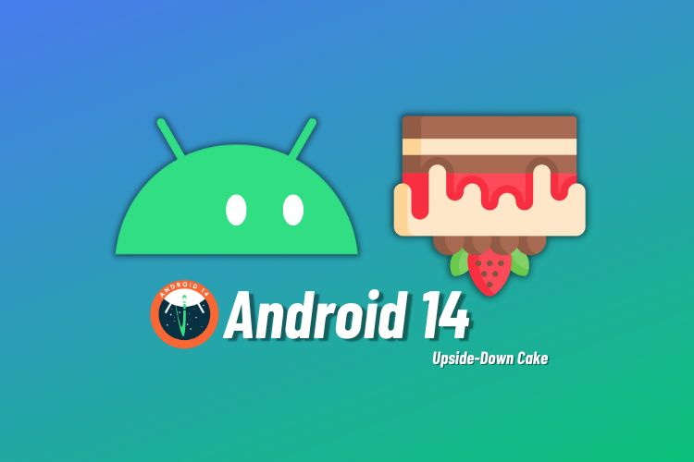

What is Mobile Application Development?

Slide 3
What is Mobile Application Development?
Mobile app development is the act or process by which a mobile app is developed for mobile devices, such as personal digital assistants, enterprise digital assistants or mobile phones.

Slide 4
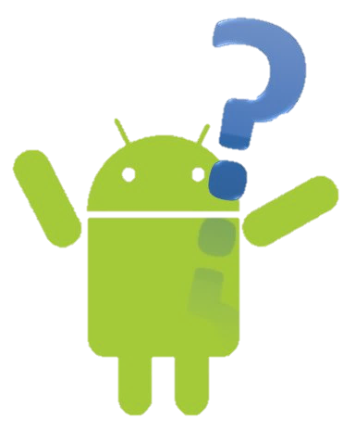
Android is an open-source and Linux-based Operating System for mobile devices such as smartphones and tablet computers.

Slide 5
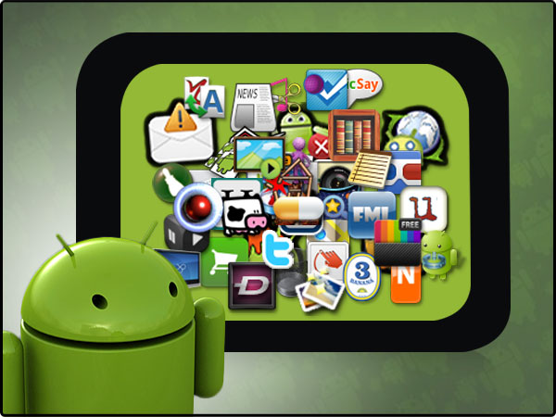
It is the world's best-selling Smartphone.
There are currently over 3.5 million apps available for Android that are made accessible through the Android Market, which is the online app store run by Google.
The apps are primarily written in Java and mostly Kotlin.
Notes:
Playstore

Slide 6
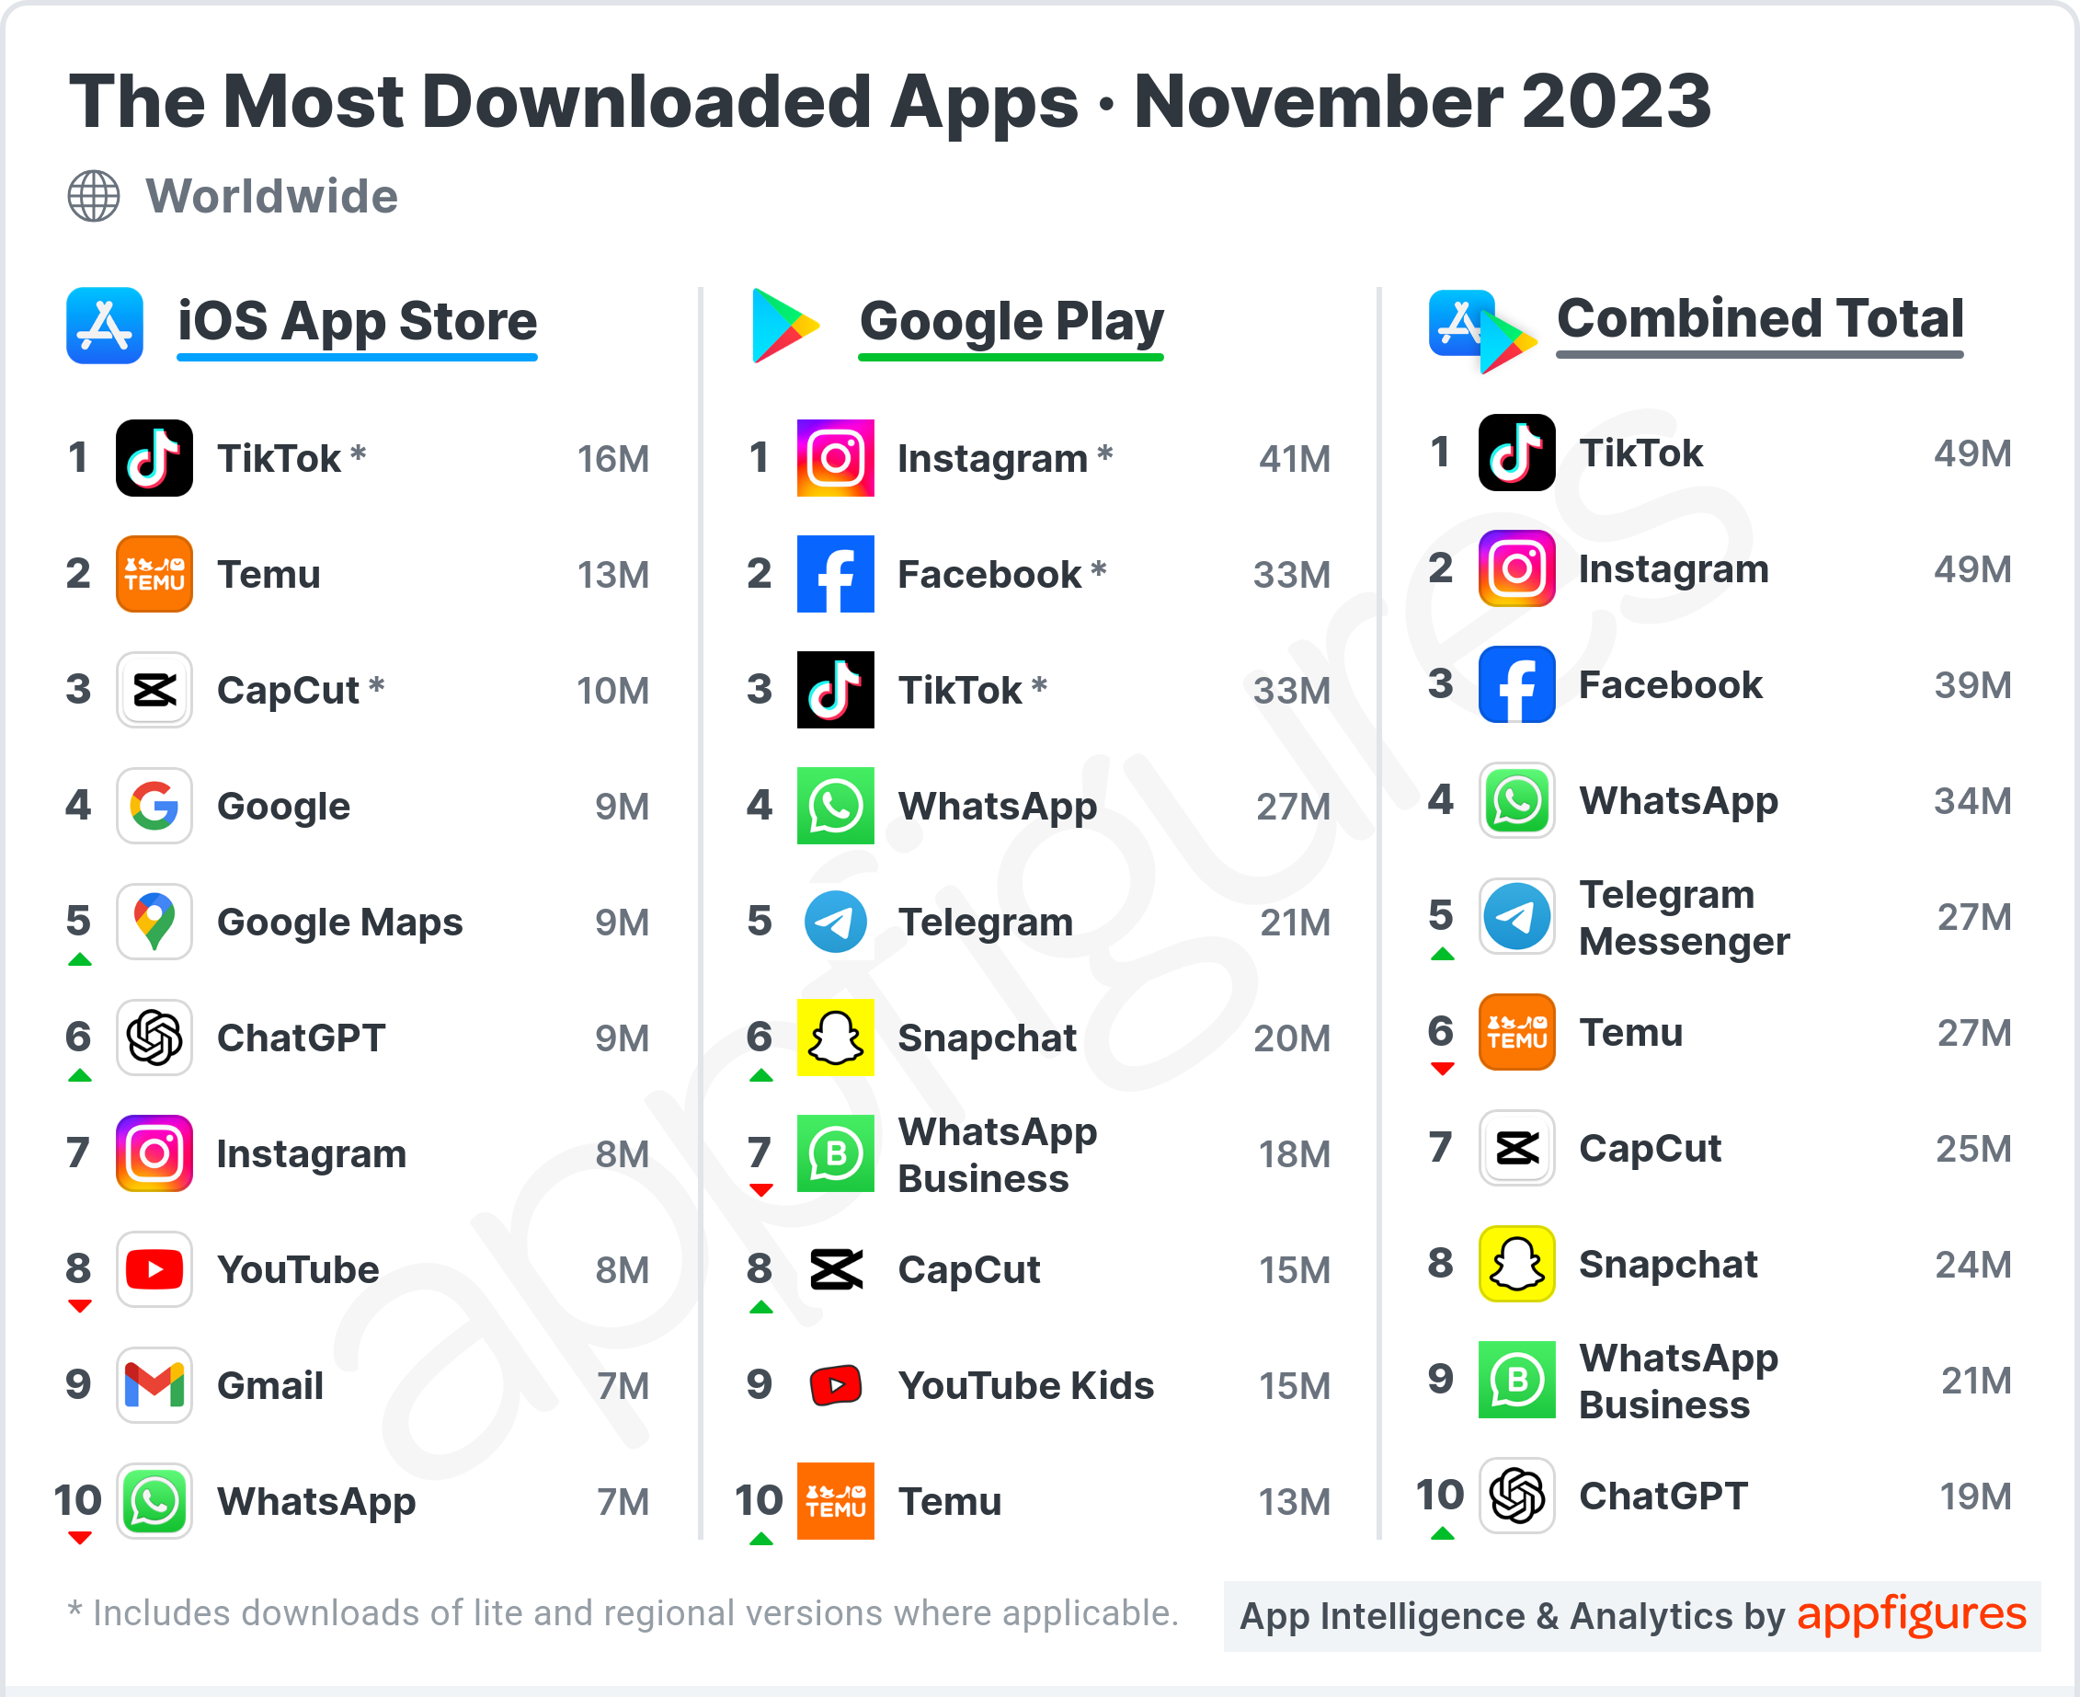
With 3.553 million mobile apps available in the Google Play Store, 3.442 million (or 96.9%) are free to download, while over 110 thousand (or 3.1%) are paid apps.

Slide 7
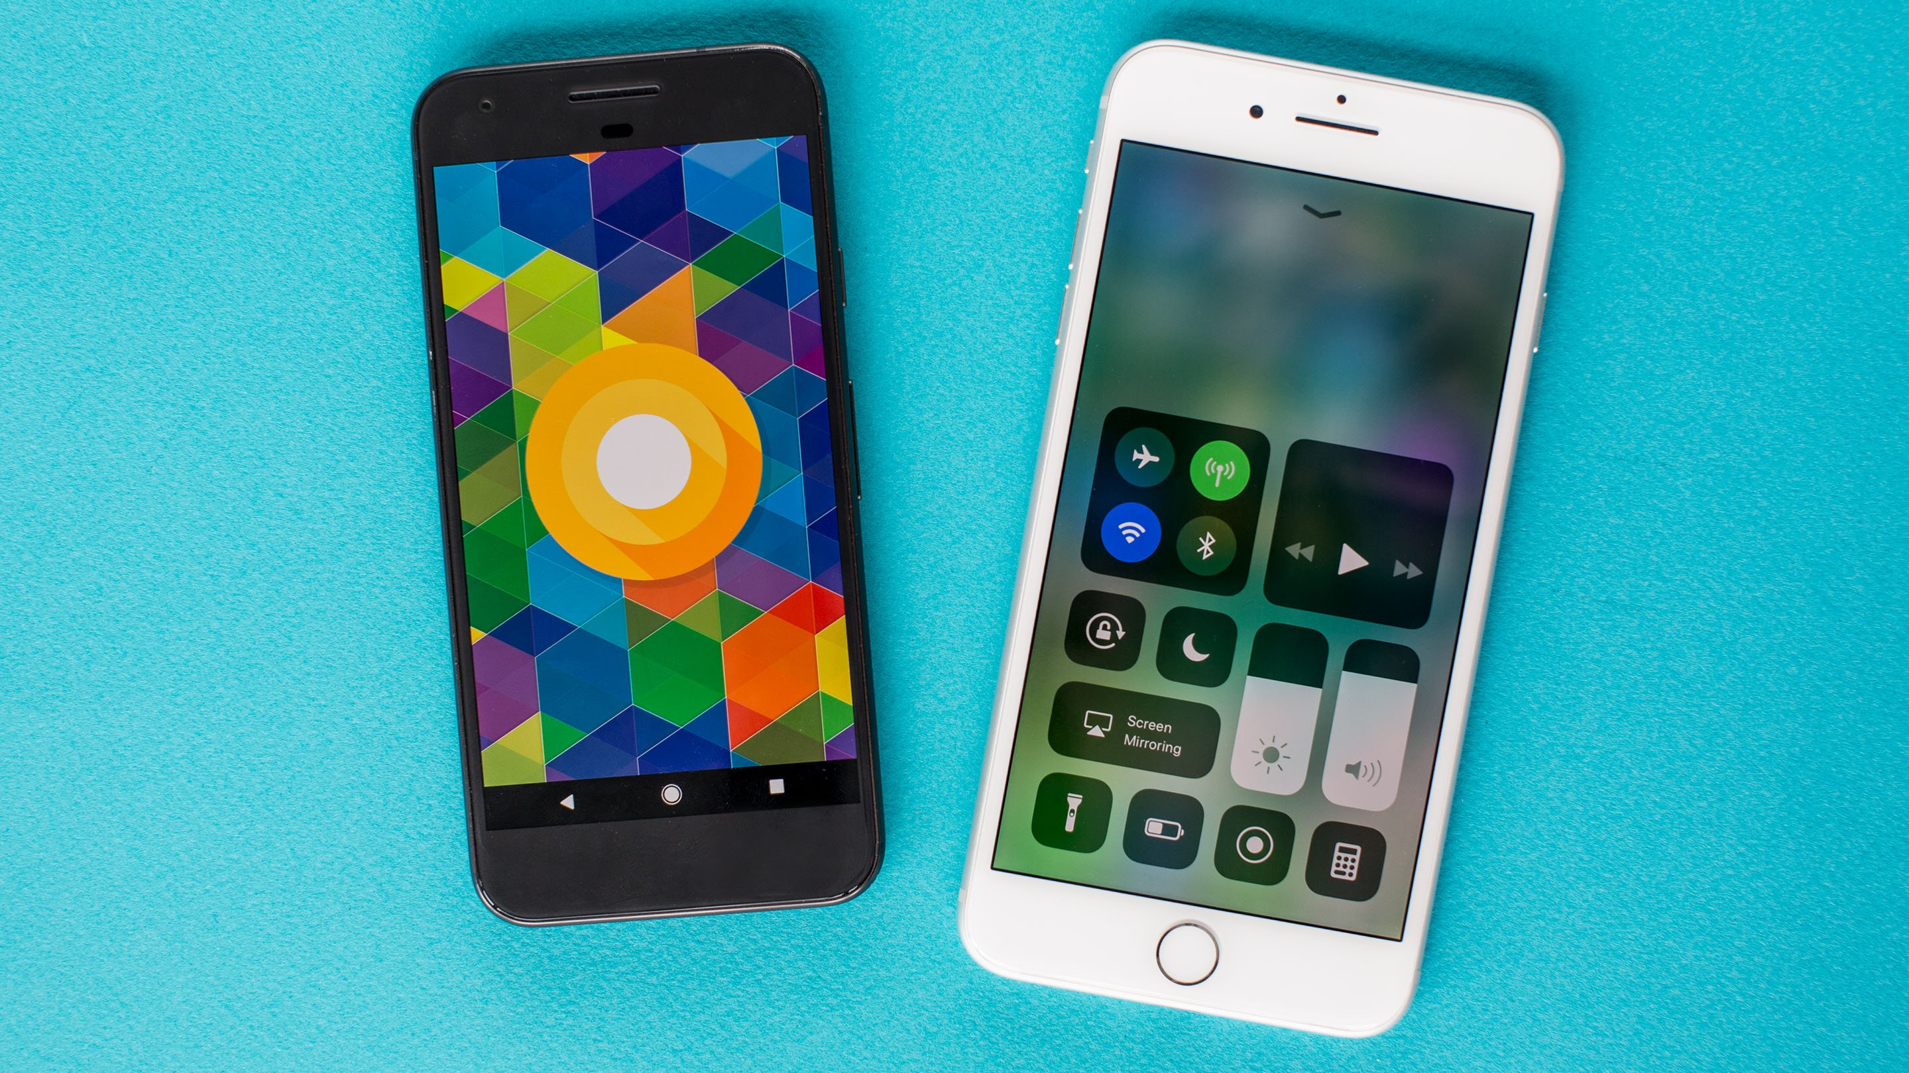
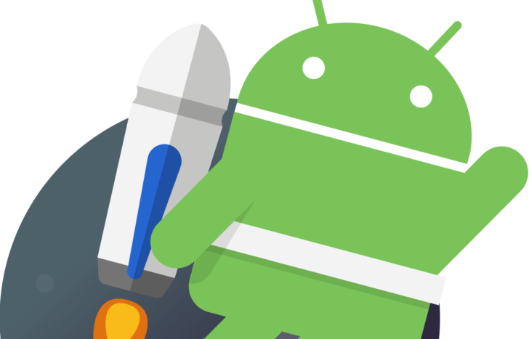
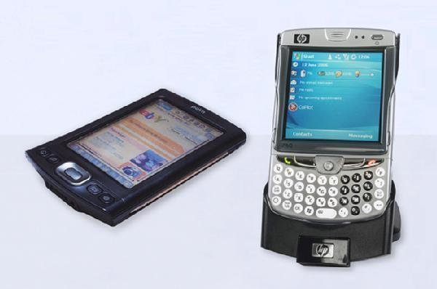

Slide 8
Why ANDROID?

Slide 9
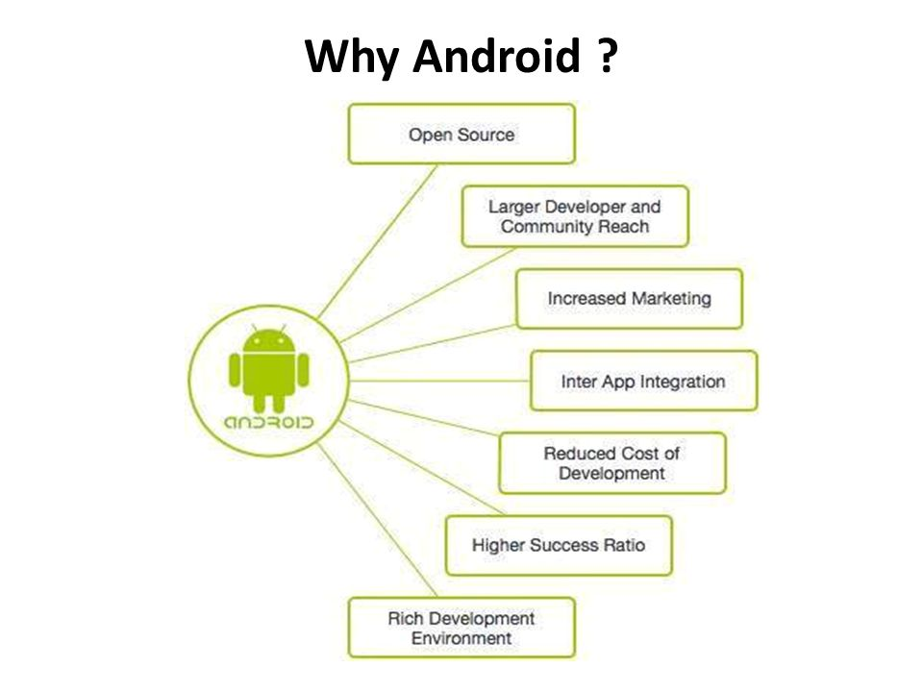
Notes:
Many applications
Mas maraming gagamit

Slide 10
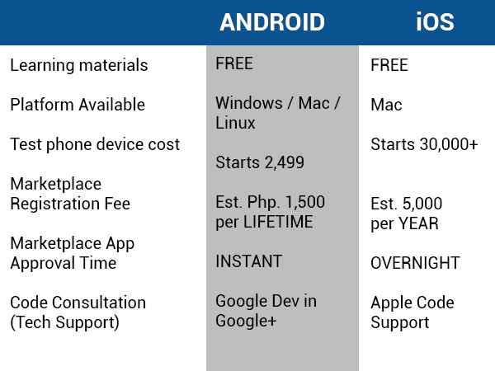

Slide 11
The ANDROID Story

Slide 12

Andy Rubin,
Founder,
Android Inc

Slide 13

Background
Android Inc. was founded in Palo Alto, California in October, 2003 by Andy Rubin, Rich Miner, Nick Sears, and Chris White.
Their goal was to develop a "smarter mobile device that was more aware of its owner's location and preferences.”
They operated secretively, admitting only that they were working on software for mobile phones.

Slide 14
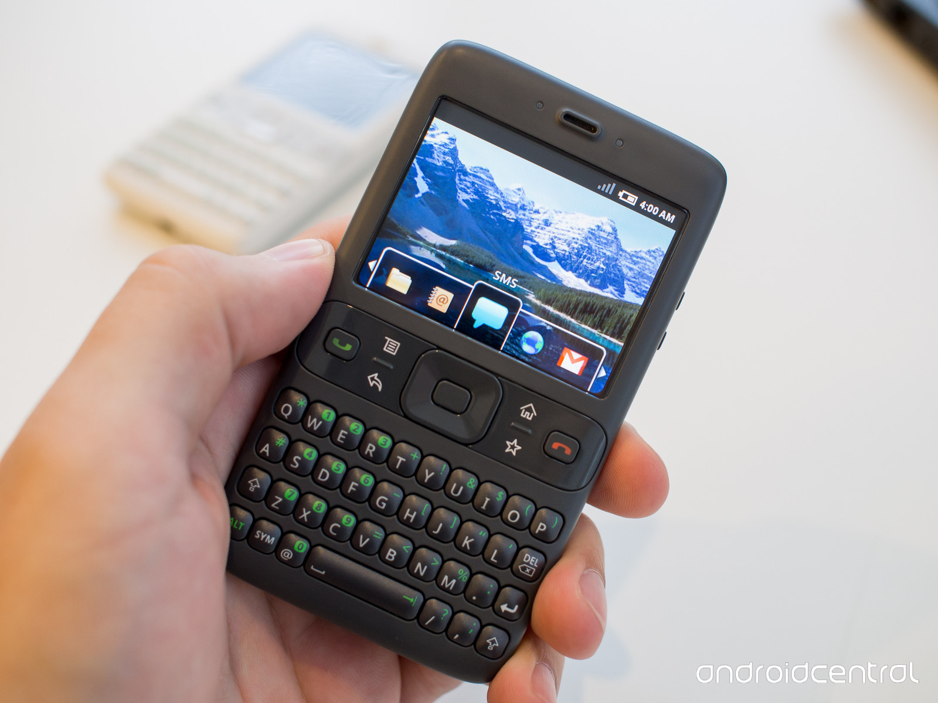

Slide 15
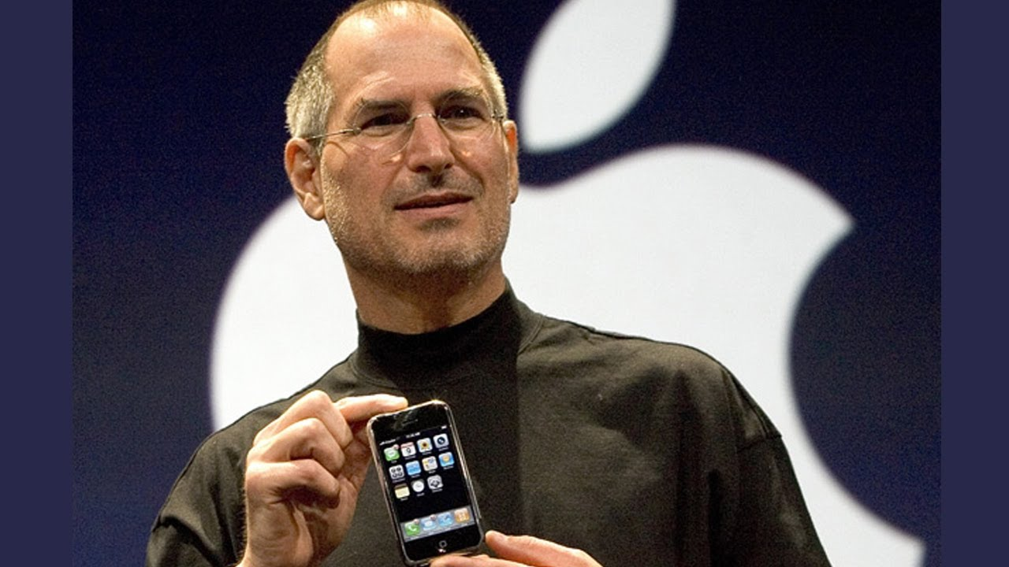

Slide 16
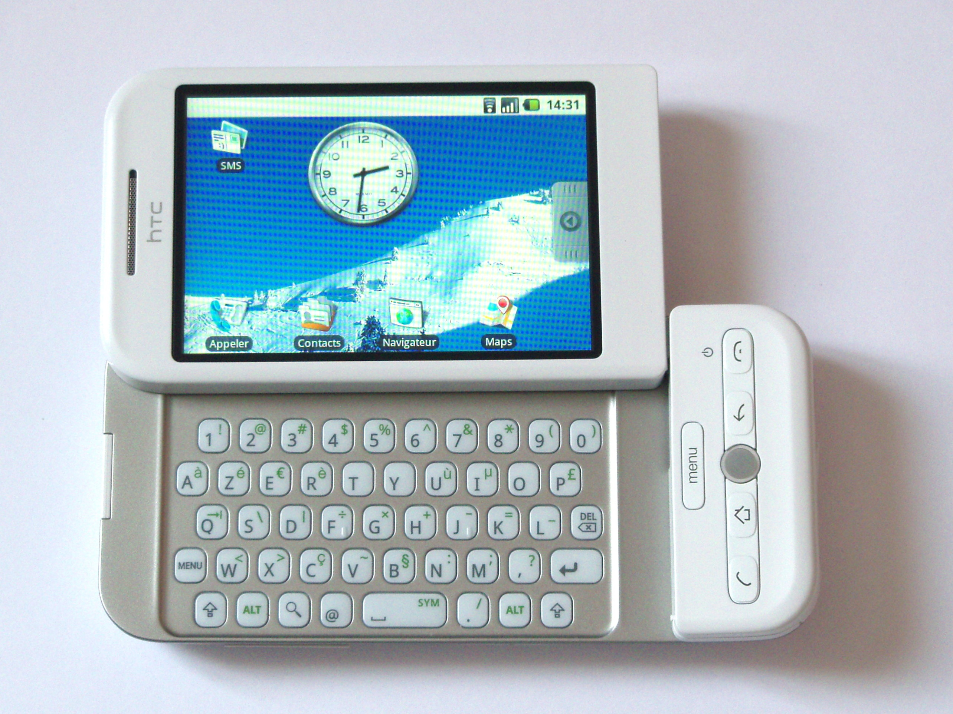
HTC Dreams

Slide 17
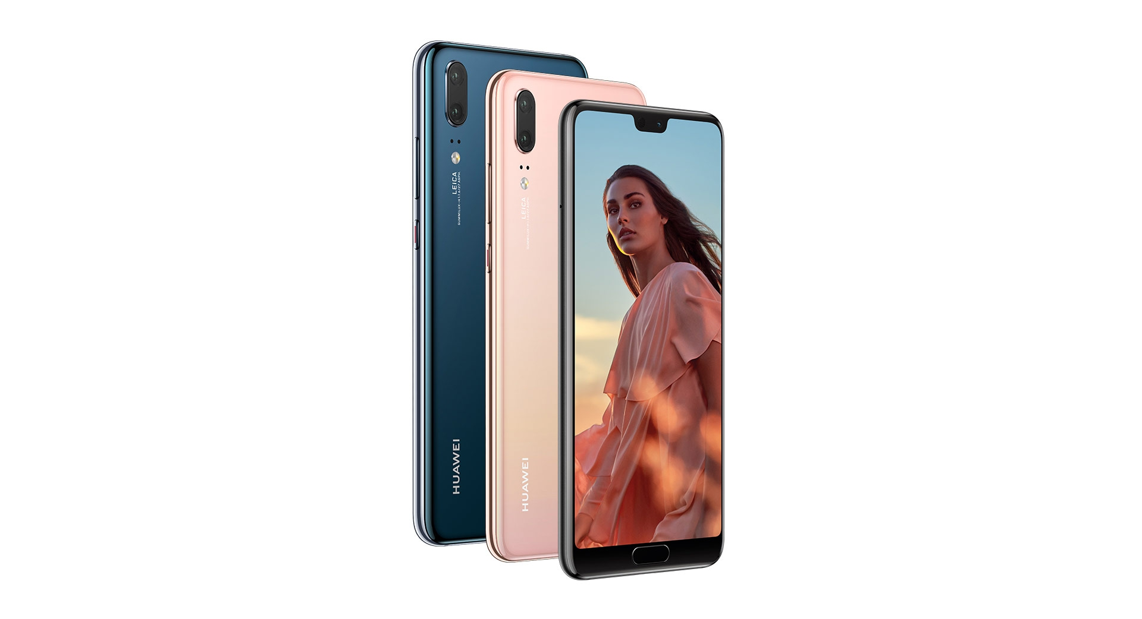
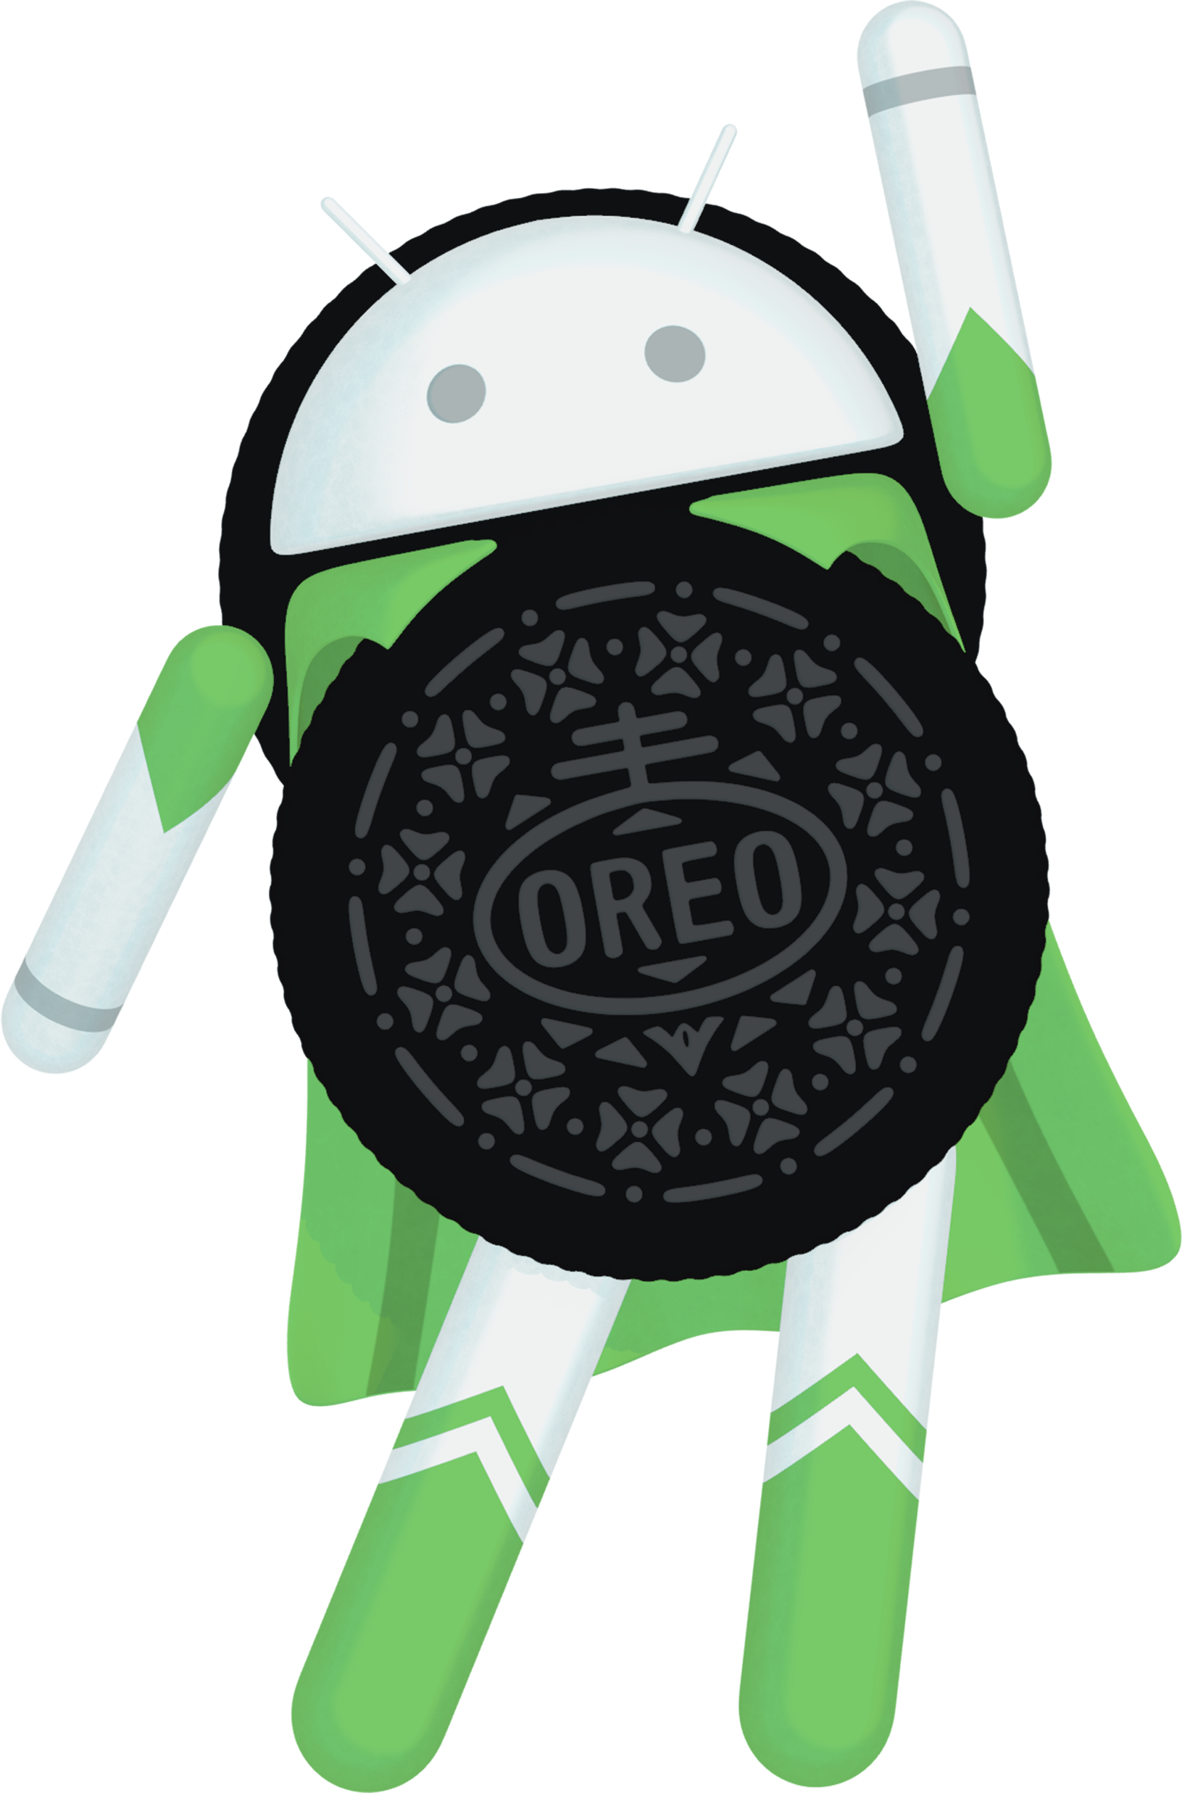
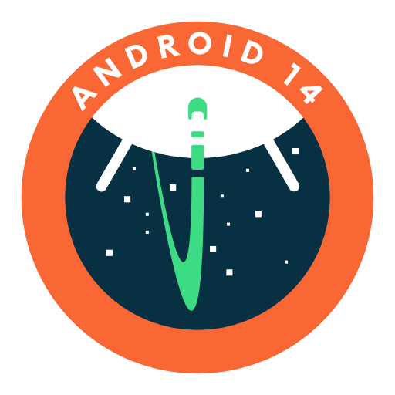
Notes:
Android flexibility and functionality
IOS –make it easy and user friendly

Slide 18
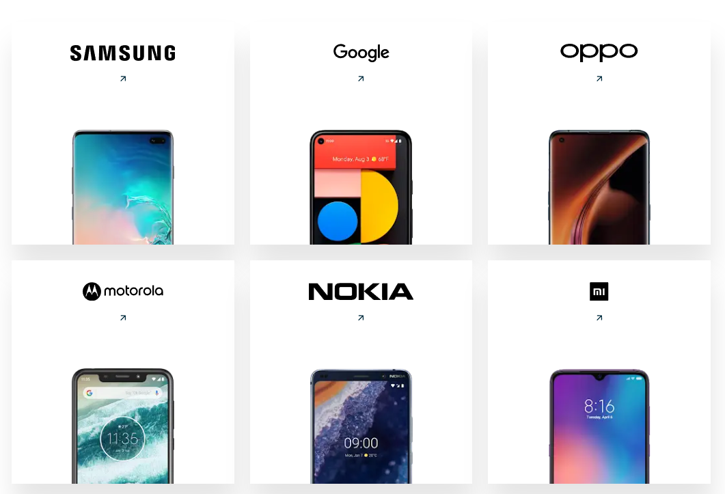

Slide 19
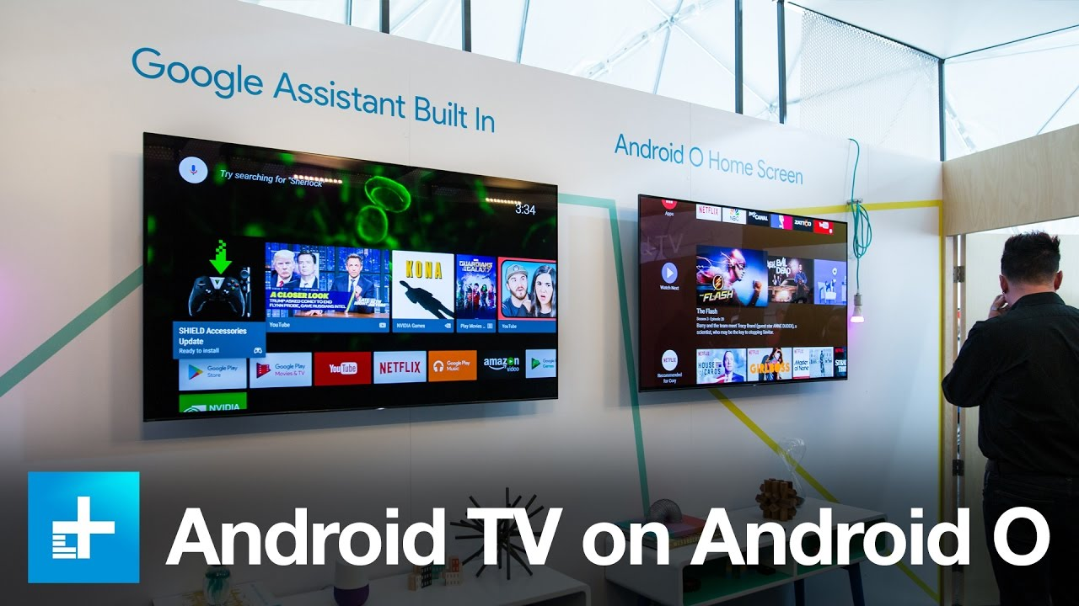

Slide 20
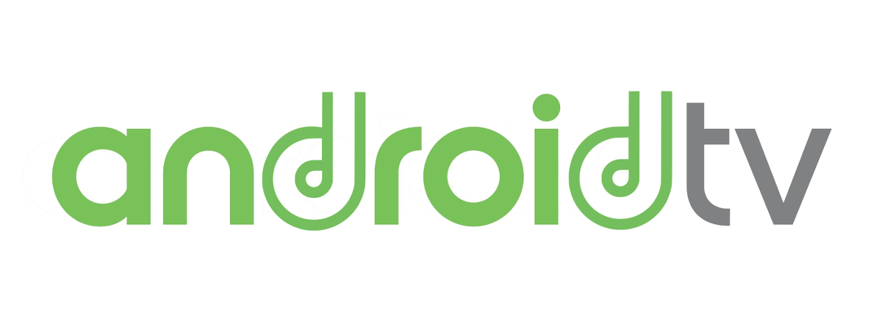
Android TV
Android TV is a version of the Android operating system designed for digital media players. A replacement for Google TV, it features a user interface designed around content discovery and voice search, surfacing content aggregated from various media apps and services, and integration with other recent Google technologies such as Assistant, Cast, and Knowledge Graph.

Slide 21
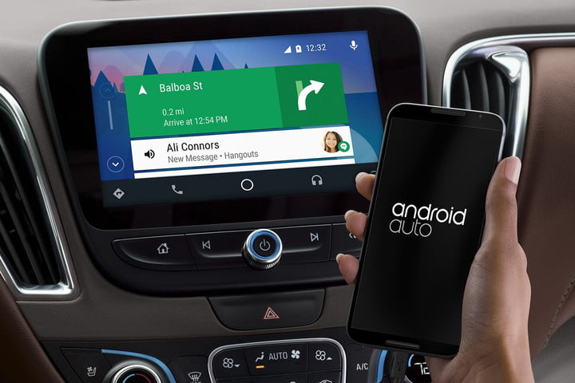

Slide 22
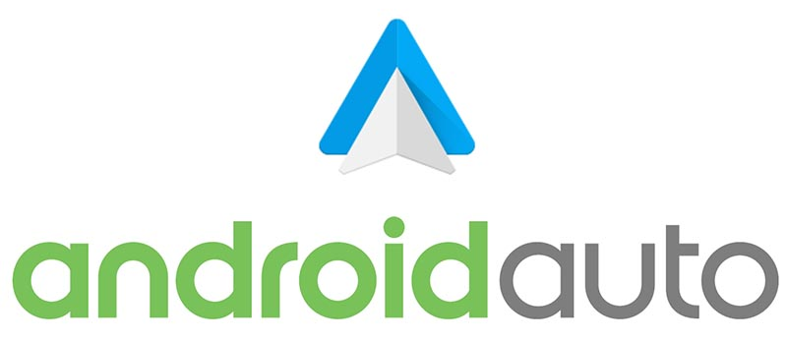
Android Auto
Android Auto is a mobile app developed by Google to mirror features from an Android device to a car's compatible in-dash information and entertainment head unit. Once an Android device is paired with the head unit, the system mirrors qualified apps from the device to the vehicle's display, with a simple, driver-friendly user interface. Supported apps, include GPS mapping/navigation, music playback, SMS, telephone, and web search. The system supports both touchscreen and button-controlled head unit displays, although hands-free operation through voice commands is encouraged to minimize driving distraction.

Slide 23
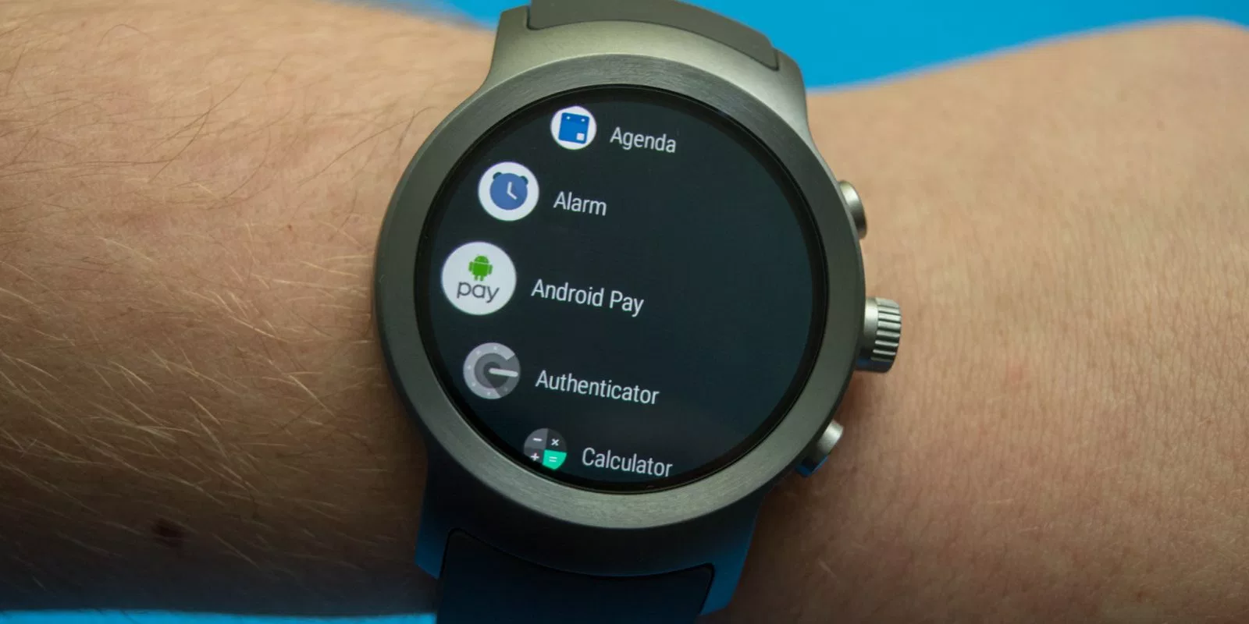

Slide 24
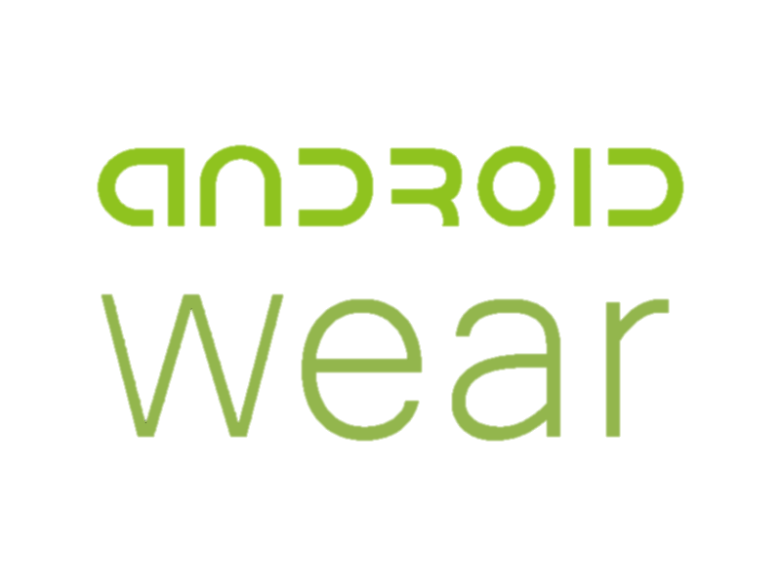
Android Wear
Wear OS, formally known as Wear OS by Google, and previously known as Android Wear, is a version of Google's Android operating system designed for smartwatches and other wearables. By pairing with mobile phones running Android version 4.3 or newer, or iOS version 8.2 or newer with limited support from Google's pairing application, Wear OS integrates Google Assistant technology and mobile notifications into a smartwatch form factor. Wear OS supports Bluetooth, Wi-Fi, 3G and LTE connectivity, as well as a range of features and applications. Watch face styles include round, square and rectangular.

Slide 25
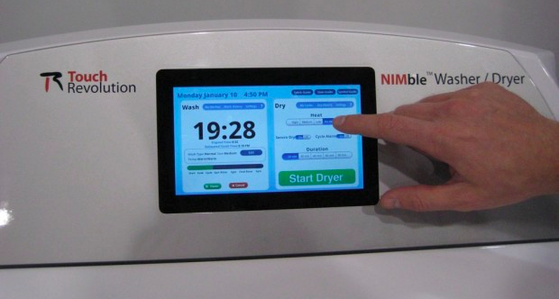
Android-Powered Washing Machine

Slide 26
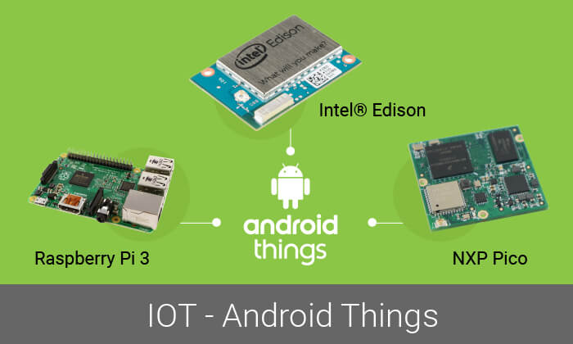

Slide 27
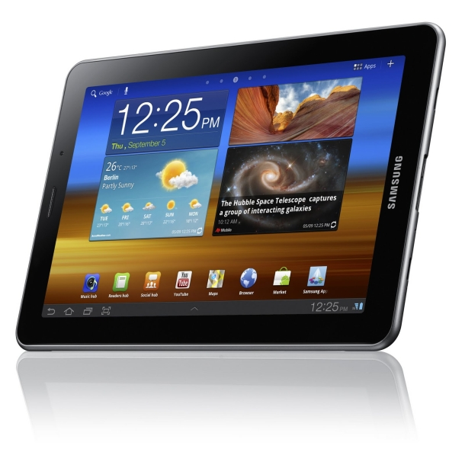

Galaxy Tablet

Slide 28
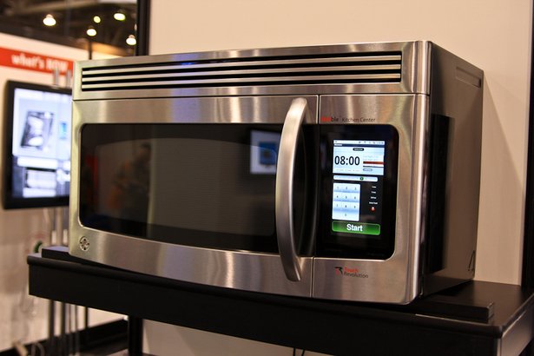
Android-Powered Microwave
By Touch Revolution – at CES 2010

Slide 29
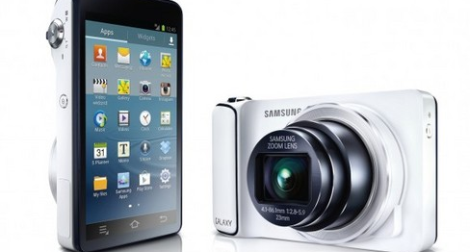
Android-Powered Camera

Slide 30
ANDROID VERSION

Slide 31
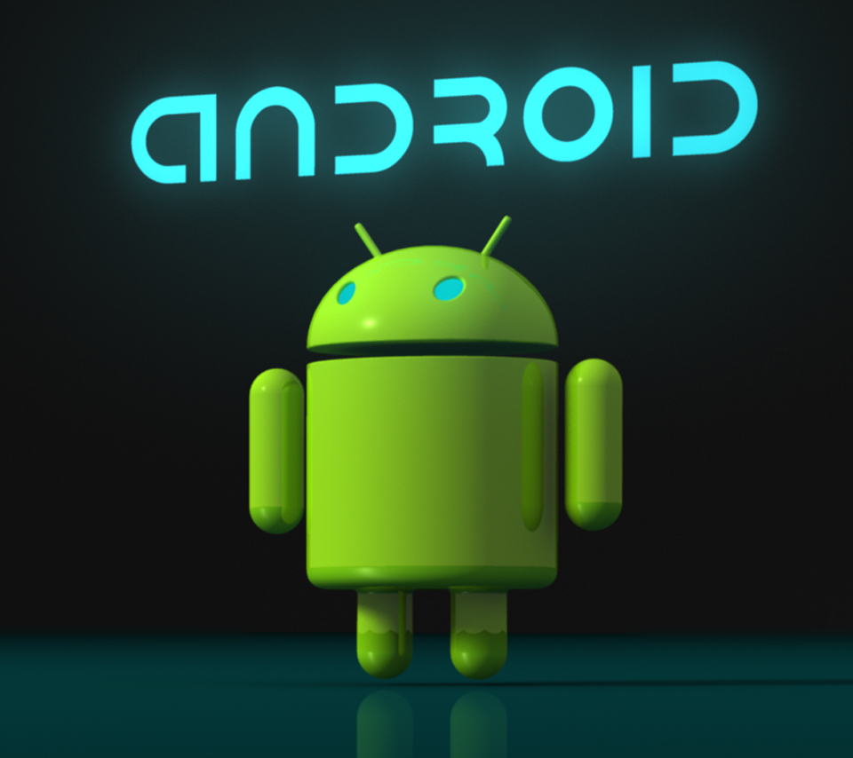
ANDROID VERSIONS
Android is a most popular Operating System for mobiles which is used by more than 2 Billion Monthly Active Android Devices. It’s an open source software written in Linux and launched by Google in 2008.
There are about 8 major versions of Android and Oreo (8.0) is a current version of android OS.
Every Android version after 1.5 has been evolved with definite code names that have been chosen in an alphabetical manner.

Slide 32
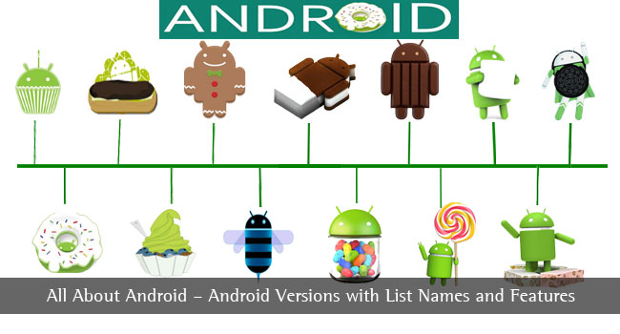

Slide 33
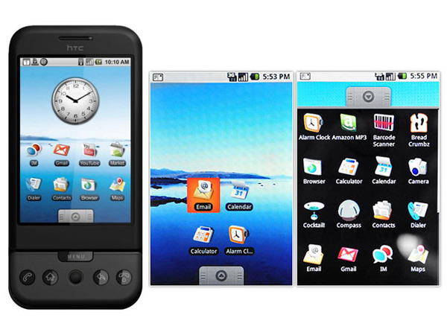
Android 1.0
Android 1.0 doesn’t have any specific code name. Gmail, Google Calendar, Google Maps, pull down notification window and Android market are the main features of this version. This version of Android had only 35 apps. Android Market allowed application downloads and updates through the Market application
Notes:
Phones specs

Slide 34
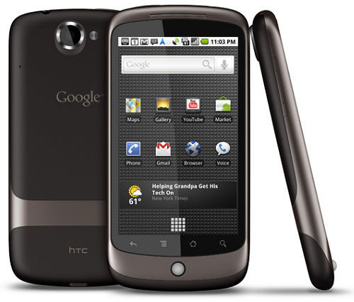
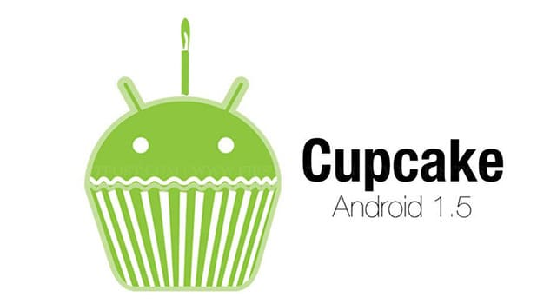
ANDROID 1.5 (CUPCAKE)
Android 1.5 was the first version to get a code name It was named as cupcake and launched in April 2009. The main feature of this version was animated transition effects. Other notable features include uploading videos to YouTube, uploading photos to Picasa, third-party virtual keyboards with text prediction and user dictionary for custom words.
Features includes: on-screen keyboard, third-party app widgets, option for video recording.

Slide 35
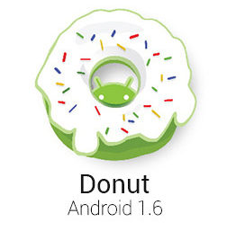
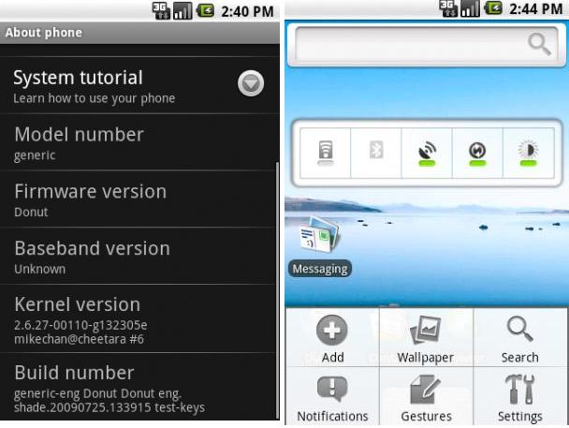
Android 1.6 (DONUT)
Android 1.6 was launched in September 2009. Multi-Select Photos in gallery, 800 x 480 resolution screen support, Android search, voice search Functionality, Handwriting gestures are some of the important features in this version.
Also, the ability for the OS to operate on a variety of different screen sizes and resolutions

Slide 36
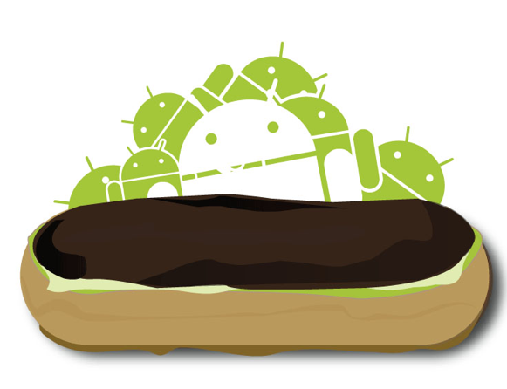
ANDROID 2.0/2.1 (Eclair)
Eclair was launched in October 2009 focusing on media features like flash support, scene mode, white balance, color effect & Digital zoom. Speech-to-text, Improved keyboard functionality and multiple home screens, Expanded Account sync and allowing users to add multiple accounts to a device for synchronization of email and contacts are other features of this version.
Also, a voice-guided turn-by-turn navigation and real-time traffic info, pinch-to-zoom capability into Android

Slide 37
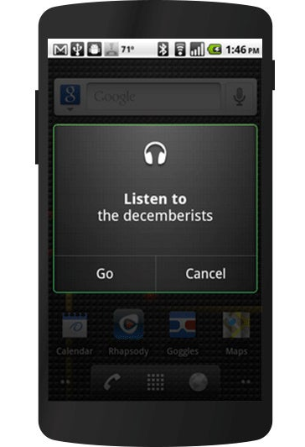
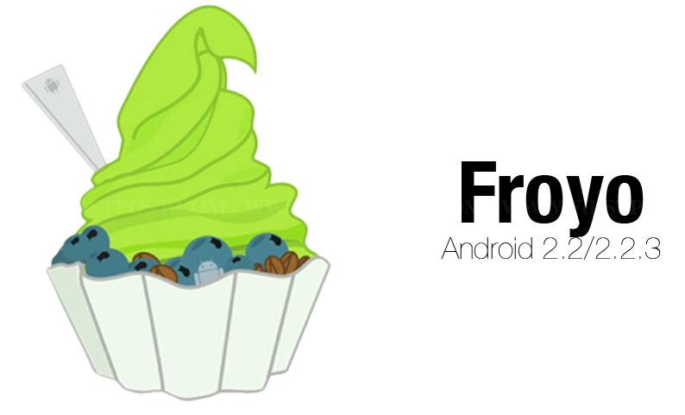
Android 2.2 (froyo)
Froyo was launched in May 2010 which included Speed, memory, performance optimizations and minor bug fixes. Froyo allowed the users to install the apps on SD card, 720p screens support, USB tethering and Wi-Fi hotspot functionality.

Slide 38
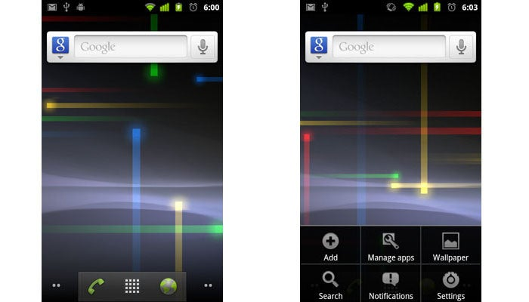
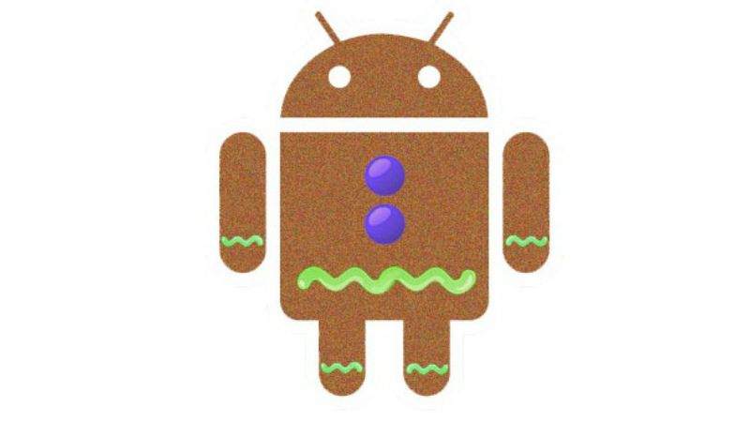
ANDROID 2.3 (gingerbread)
Gingerbread was launched in December 2010. Internet telephone, video chat capability and NFC communications are main features of gingerbread. Support for multiple cameras on the device, voice or video chat support using Google Talk, Google Wallet for the Nexus S 4G are other notable features.

Slide 39

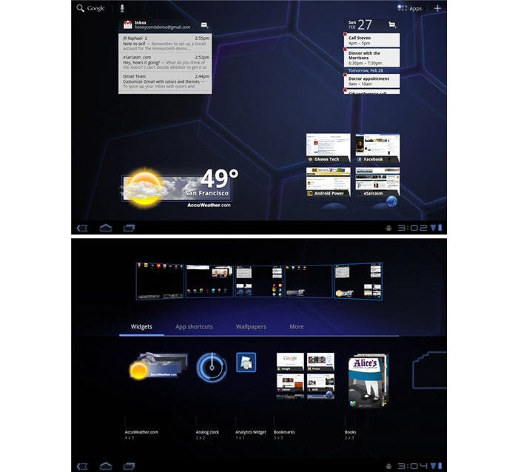
Android 3.0/3.1/3.2 (Honeycomb)
Honeycomb was launched in February 2011 and was mainly designed for Tablets. Multiple browser tabs, incognito mode, Redesigned UI and keyboard, Hardware acceleration and accurate on larger screen sizes, ability to encrypt all user data are features of Honeycomb.

Slide 40
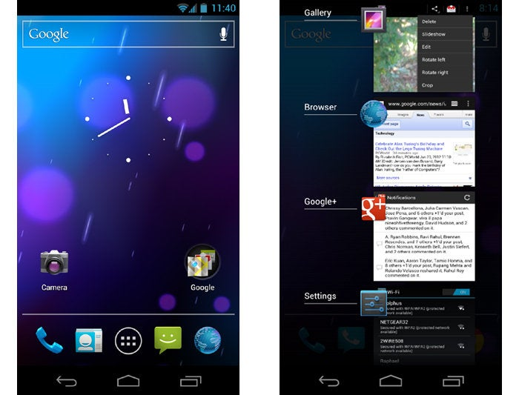
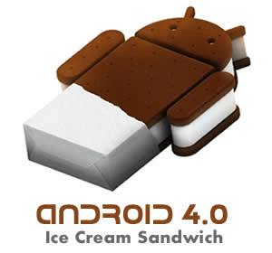
Android 4.0 (ice cream sandwich)
Ice Cream Sandwich was launched in October 2011 and improved UI is major update of this version. Multicore CPU support, virtual buttons, Face Unlock feature and improved copy and paste functionality are some of the important features of ice cream sandwich. This version also provided features like Easier-to-create folders, with a drag-and-drop style, Pinch-to-zoom functionality in the calendar and Built-in photo editor.

Slide 41
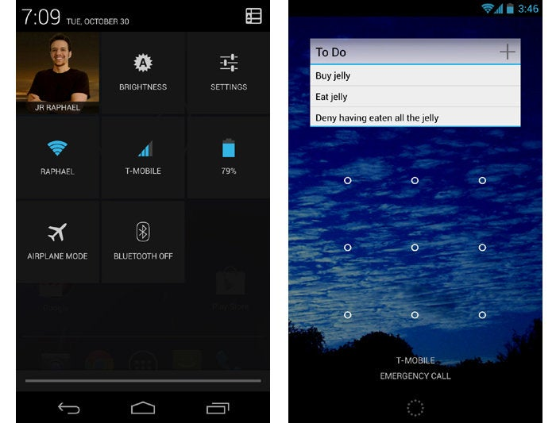
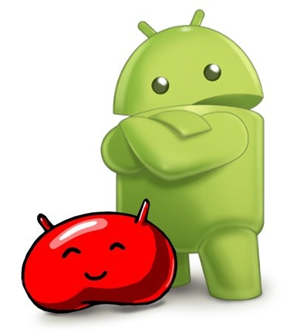
Android 4.1 / 4.2 / 4.3 (Jelly Bean)
Jelly Bean was launched in July 2012 with may bug fixes. Smoother UI, Enhanced accessibility, New clock application with built-in world clock, stop watch and timer, Group Messaging, Native emoji support are major features of Jelly Bean.

Slide 42
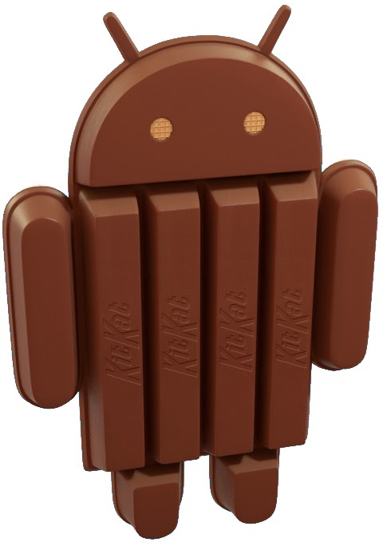
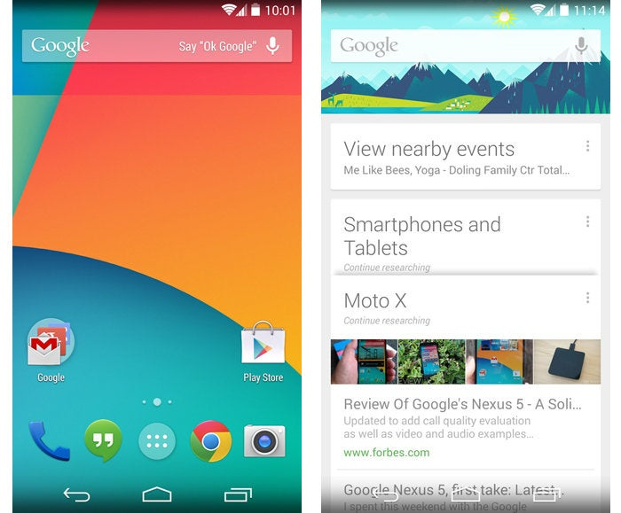
Android 4.4 (Kitkat)
KitKat was launched in October 2013. It runs fast, smooth, and responsively on a much broader range of devices. Low power consumption sensors, improved NFC communications, printing framework, translucent UI styling and “Ok, Google” support are main features of KitKat versions.

Slide 43
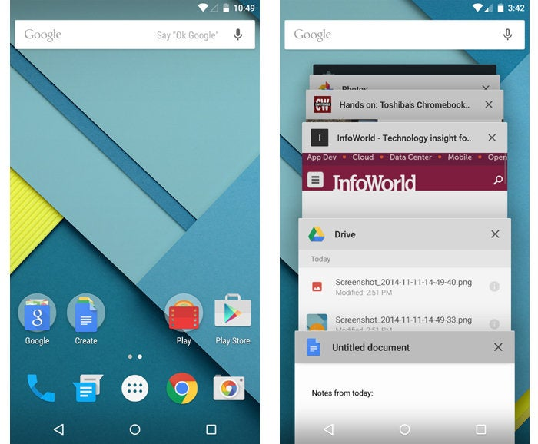
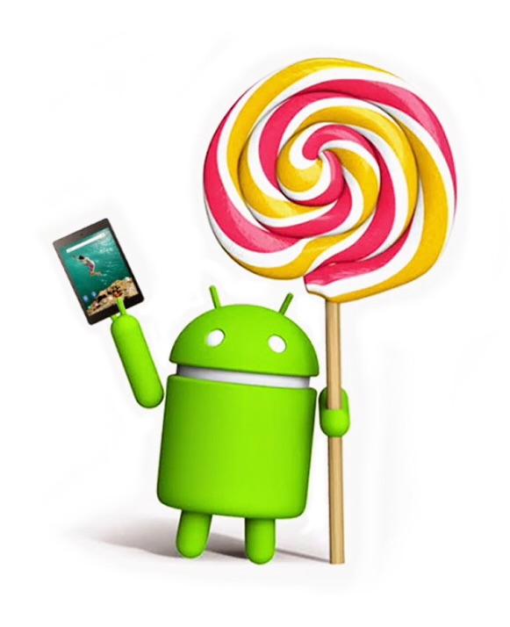
Android 5.0 / 5.1 (Lollipop)
On November 2014 google launched Android Lollipop that mainly focused on Performance. High-performance graphics, powerful audio, Screen capturing and sharing and Document-centric apps and card-based concept are main features of Lollipop version.

Slide 44
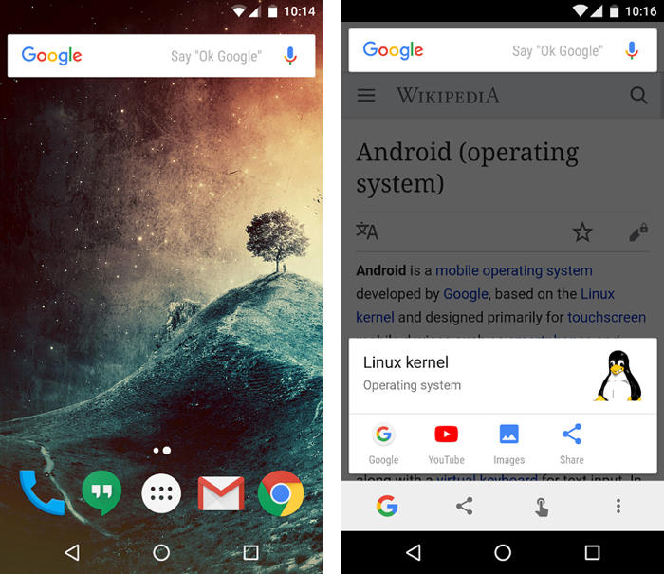
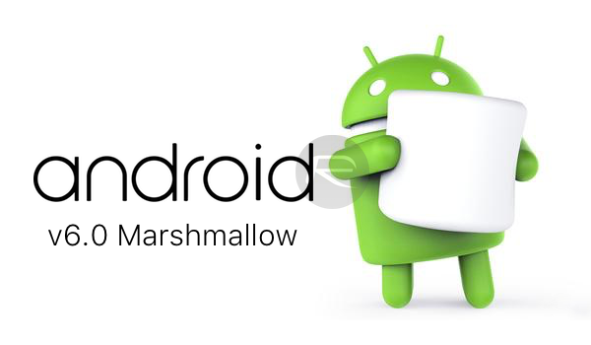
Android 6.0 (Marshmallow)
Marshmallow was launched in October 2015. Audio Manager changes, Text Selection, Browser Bookmark Changes, Android KeyStore Changes and USB Connection, support for fingerprint readers, and support for USB-C. are main updates of this version.

Slide 45


ANDROID 7.0 (NOUGAT)
Nougat was launched in August 2016. Scoped Directory Access, Direct Boot, Messaging Service Active Notifications, Data Saver feature, Alt-Tab-like shortcut and Multi-Window Playground and Google Assistants are main updates in this version.

Slide 46


Android 8.0 (oreo)
Oreo was launched in August 2017. Autofill Framework, Downloadable Fonts, Picture-in-Picture Mode, Notification Channels, Background Execution Limits, Background Location Restrictions and audio are main updates in Oreo.

Slide 47


ANDROID 9.0 (PIE)
Pie's most transformative change was its hybrid gesture/button navigation system, which traded Android's traditional Back, Home, and Overview keys for a large, multifunctional Home button and a small Back button that appeared alongside it as needed. Universal suggested-reply system for messaging notifications, a new dashboard of Digital Wellbeing controls, and more intelligent systems for power and screen brightness management.

Slide 48


ANDROID 10.0 (Quince Tart)
Google released Android 10 — the first Android version to shed its letter and be known simply by a number, with no dessert-themed moniker attached — in September of 2019. Android 10 packed plenty of other quietly important improvements, including an updated permissions system with more granular control over location data along with a new system-wide dark theme, a new distraction-limiting Focus Mode, and a new on-demand live captioning system for any actively playing media.

Slide 49


ANDROID 11.0 (Red Velvet Cake)
Android 11, launched at the start of September 2020, was a pretty substantial Android update both under the hood and on the surface. The version's most significant changes revolve around privacy: The update built upon the expanded permissions system introduced in Android 10 and added in the option to grant apps location, camera, and microphone permissions only on a limited, single-use basis.

Slide 50


ANDROID 12.0/12.0L (Snow Cone)
Google officially launched the final version of Android 12 in October 2021, alongside the launch of its Pixel 6 and Pixel 6 Pro phones. In a twist from the previous several Android versions, the most significant progressions with Android 12 were mostly on the surface. Android 12 featured the biggest reimagining of Android's interface since 2014's Android 5.0 (Lollipop) version, with an updated design standard known as Material You — which revolves around the idea of you customizing the appearance of your device with dynamically generated themes based on your current wallpaper colors.

Slide 51

ANDROID 14 (Upside Down Cake)
Google's 14th Android version landed at the start of October 2023 in the midst of the company's Pixel 8 and Pixel 8 Pro launch event. The software introduces a new system for dragging and dropping text between apps, for instance, as well as a new series of native customization options for the Android lock screen.
Android 14 provides a number of new improvements to privacy and security, too, including a new settings-integrated dashboard for managing all your health and fitness data and controlling which apps and devices can access it.
The software also sports a series of significant accessibility additions, such as an enhanced on-demand magnifier, an easier way to increase font size in any app, improved support for hearing aid connections, and a built-in option to have your phone flash its camera light anytime a new notification arrives.
Beyond that, Android 14 features a first taste of Google's AI-generated custom wallpaper creator, though that's available only on the Pixel 8 and Pixel 8 Pro to start.

Slide 52

Android 15.0 (Vanilla Ice Cream)

Slide 53
Getting Started with Android Development

Slide 54


Slide 55
THINGS WE NEED TO GET STARTED

Slide 56

https://developer.android.com/studio/
Notes:
Koala
Jellyfish
Iguana
Hedgehog
Giraffe
Flamigo

Slide 57


Test Device / Simulator

Slide 58
GET TO KNOW THE ANDROID STUDIO UI

Slide 59


Slide 60
Android Studio UI
Toolbar: Carry out a wide range of actions, including running your app and launching Android tools.
Navigation bar: Navigate through your project and open files for editing. It provides a more compact view of the structure visible in the Project window.
Editor window: Create and modify code. Depending on the current file type, the editor can change. For example, when viewing a layout file, the editor displays the Layout Editor.

Slide 61
Android Studio UI
4. Tool window bar: Use the buttons on the outside of the IDE window to expand or collapse individual tool windows.
5. Tool windows: Access specific tasks like project management, search, version control, and more. You can expand them and collapse them.
6. Status bar: Display the status of your project and the IDE itself, as well as any warnings or messages.

Slide 62
Thank you!

